Slide 1
RBAC Automation
SnowBits
Snowflake Professional Services
Ihor Karbovskyy | AUGUST 2019
Notes:
Designed in PS Security Tech Group

Slide 2
AGENDA
Application Overview
Current Stage
Code Preview
Running Application
Future Improvements
Notes:
Presenter intro slide

Slide 3
APPLICATION OVERVIEW

Slide 4
OVERVIEW
The outcome of the process is expected to have a script in Snowflake that will create ROLES and GRANTS. Roles may have hierarchy levels, with access permissions to the data objects, based on preset RBAC access matrix (RAM) what should be discussed, designed and approved by customer.
In future releases, for the application it will be possible to set predefined Role model option, as Simple Domain model, Multi Domain model, with additional support roles as ETL, Reports, Providers.

Slide 5
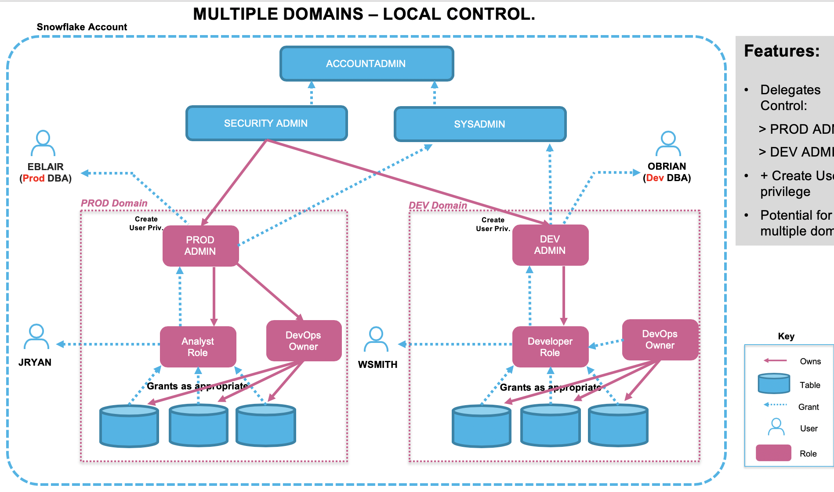
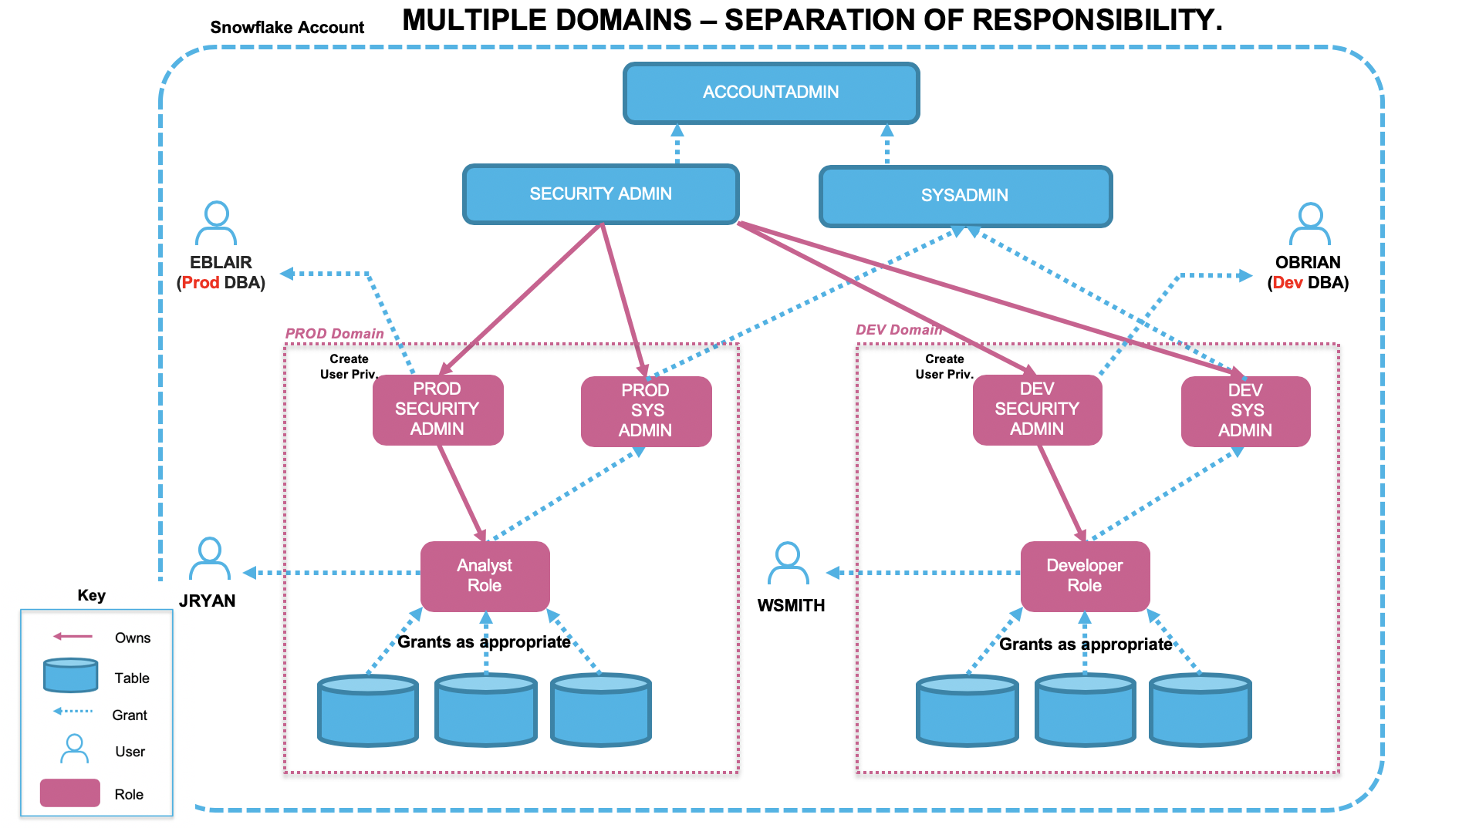
OVERVIEW
Examples for Predefined Options
Notes:
PS Security Group may create few different RAM options with predefined Roles, Access level, Data warehouse Sizes to satisfy some options for various customers.

Slide 6
CURRENT STAGES

Slide 7
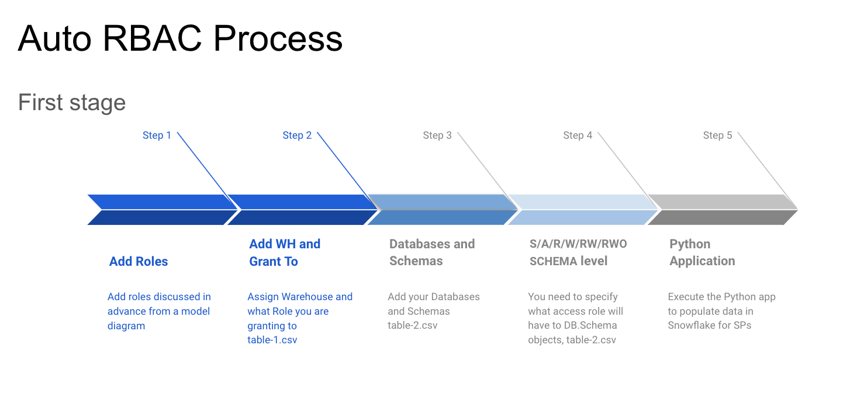
First Stage
Notes:
First Stage – We are Using HTML Pages to add data

Slide 8
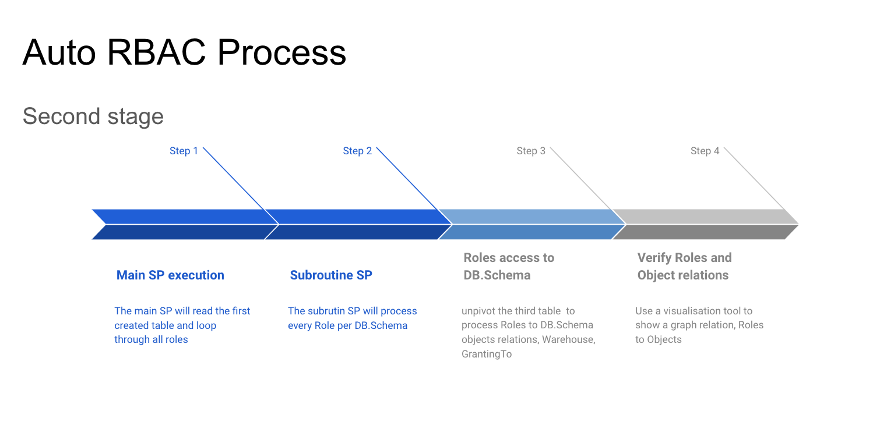
Second Stage
Notes:
Presenter intro slide

Slide 9
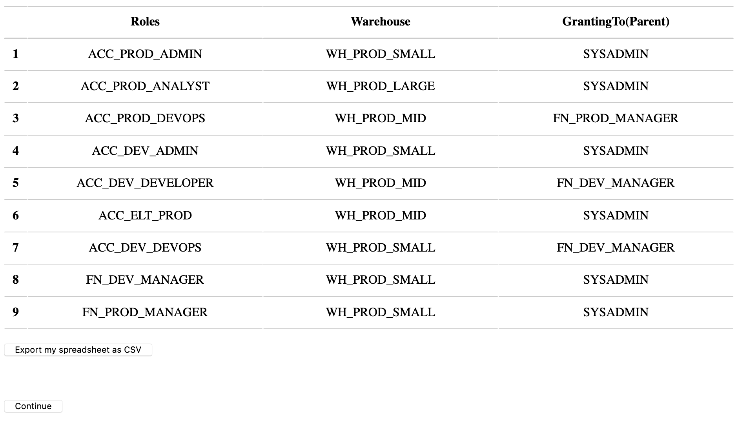
Insert initial data for Roles, Warehouses

Slide 10
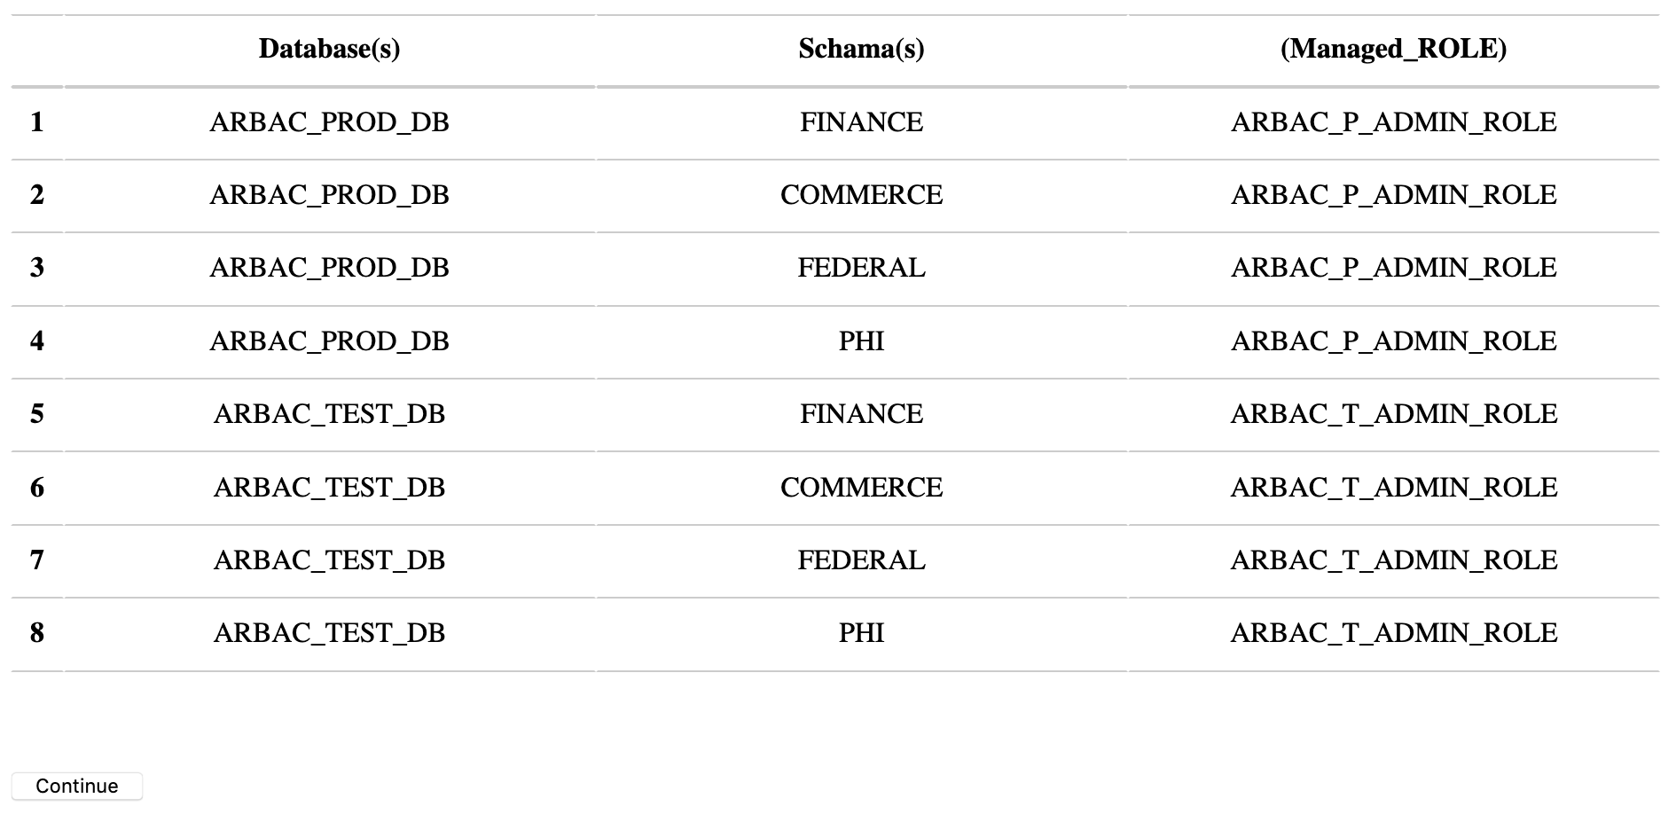
Insert initial data for DB, Schema, Managed Role

Slide 11
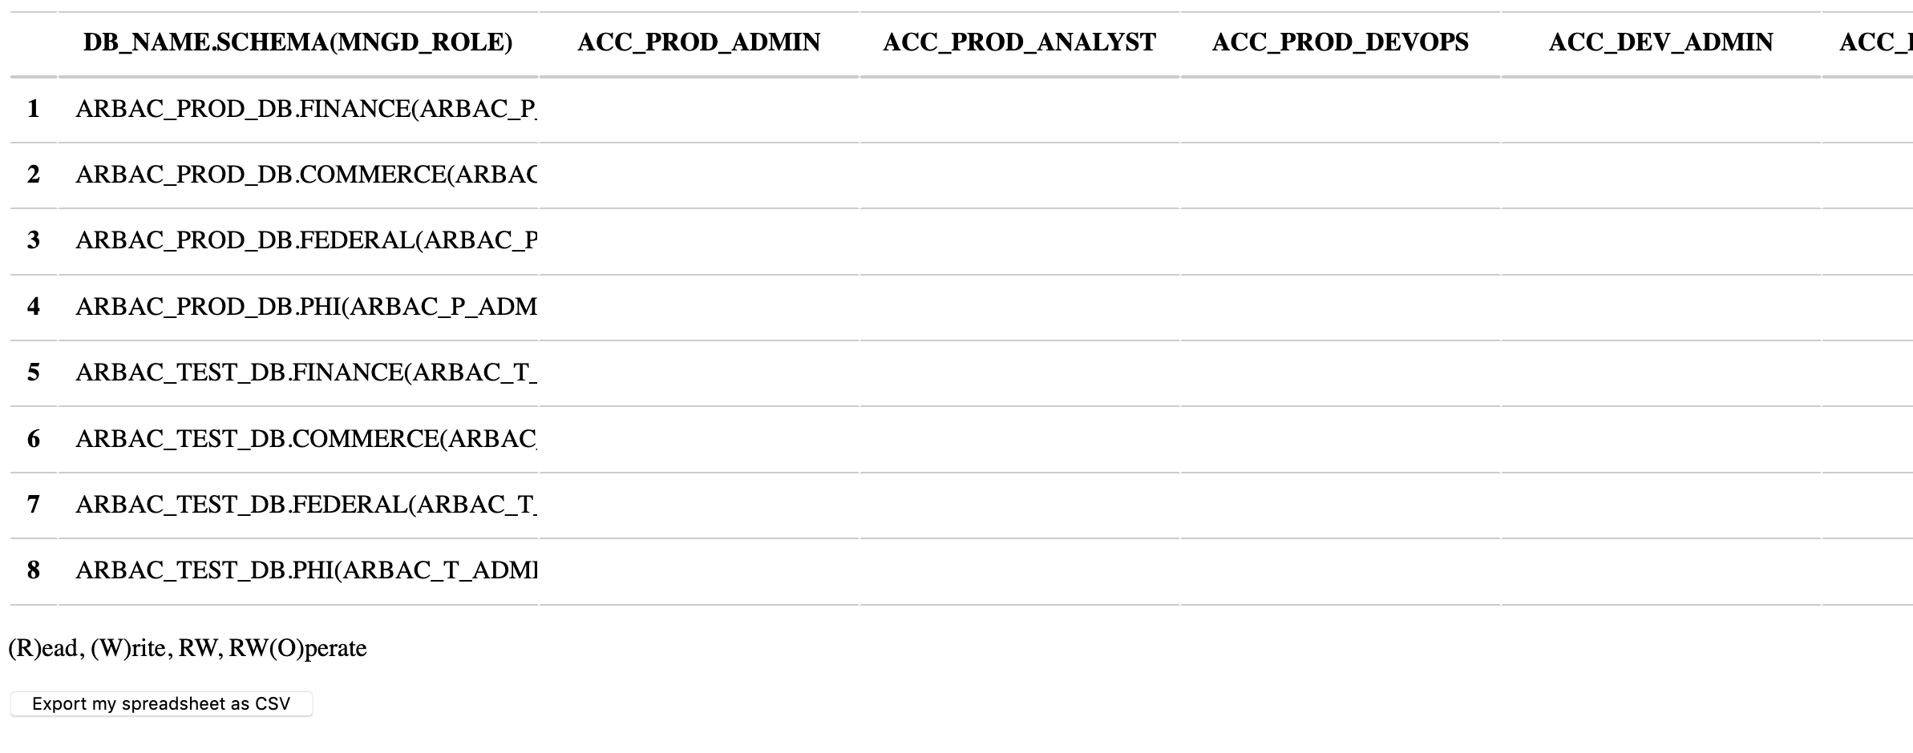
Role Access Matrix for Permissions

Slide 12
RAM Permissions
Combinations: S | A - should be used only as a separate setting
R, W, RW, RW(O).
S(ecurity) - ‘grant CREATE USER, CREATE ROLE, MANAGE GRANTS to role ...’
A(dmin) - NO READ-WRITE on tables, will have ALL privileges on databases and schemas, plus ‘grant CREATE DATABASE, CREATE WAREHOUSE, CREATE SHARE, IMPORT SHARE ...’
R - ‘grant select on all tables in schema ’
W - ‘GRANT INSERT, UPDATE, DELETE, REFERENCES ON ALL TABLES IN SCHEMA ...’
RW - ‘GRANT ALL ON ALL TABLES IN SCHEMA ...’
RWO - in combination with ‘RW’ - ‘O’ has ‘grant USAGE on database…’ and ‘GRANT ALL ON SCHEMA ...’
Notes:
RBAC Access Matrix

Slide 13
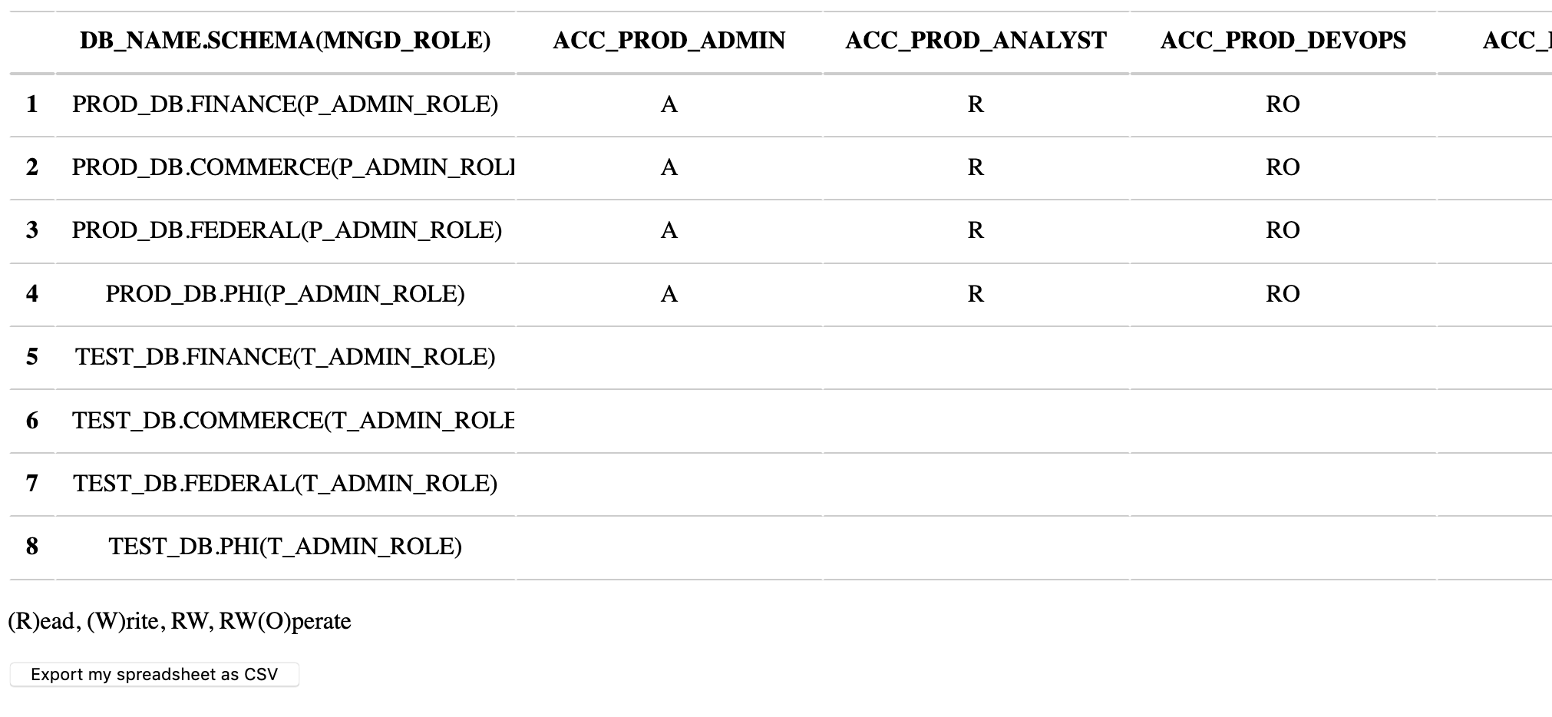
Role Access Matrix for Permissions
Notes:
From Previously discussed Matrix

Slide 14
Process initial data
Python application will be executed and will use two tables from Stage One. The app will copy data from the CSVs files to tables ‘ROLE_RBAC_MAIN_PY’ and ‘RBAC_DB_ACCESS_MNGD’.
The Python application will call a stored procedure ‘SP_RBAC_PROCESSOR()’ to create the output script.
The main SP will read data from the first created table and will call subroutine process.
Notes:
Main logic is in a Stored Procedure, because most people more familiar with SQL than Python

Slide 15
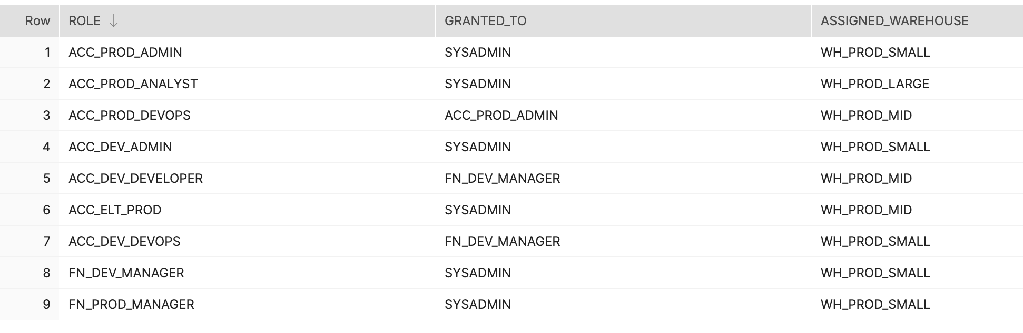
ROLE_RBAC_MAIN_PY from ‘table-1.csv’

Slide 16
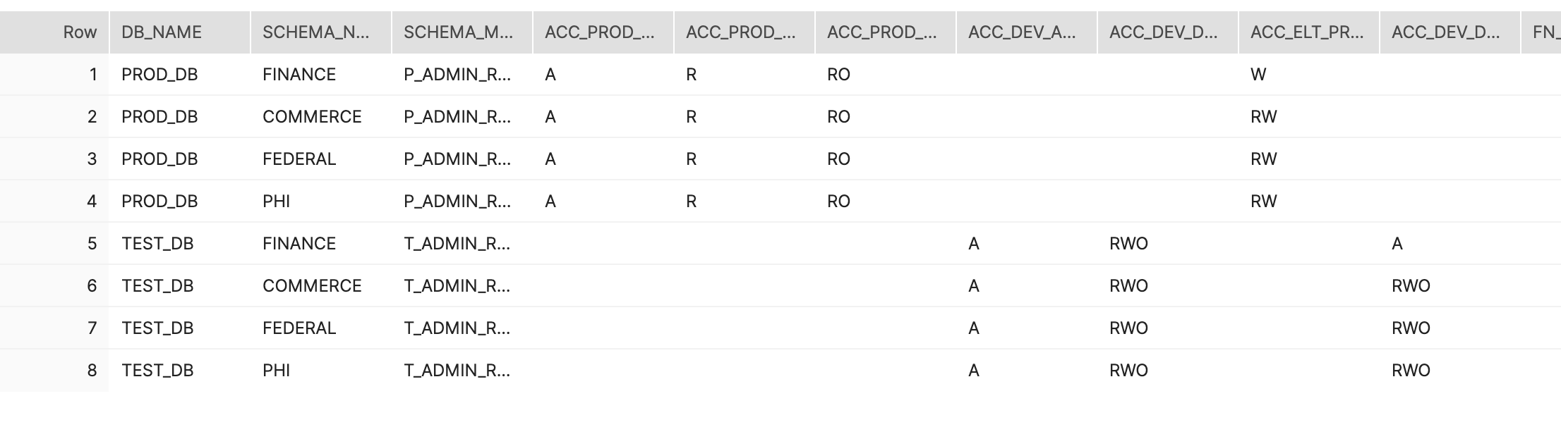
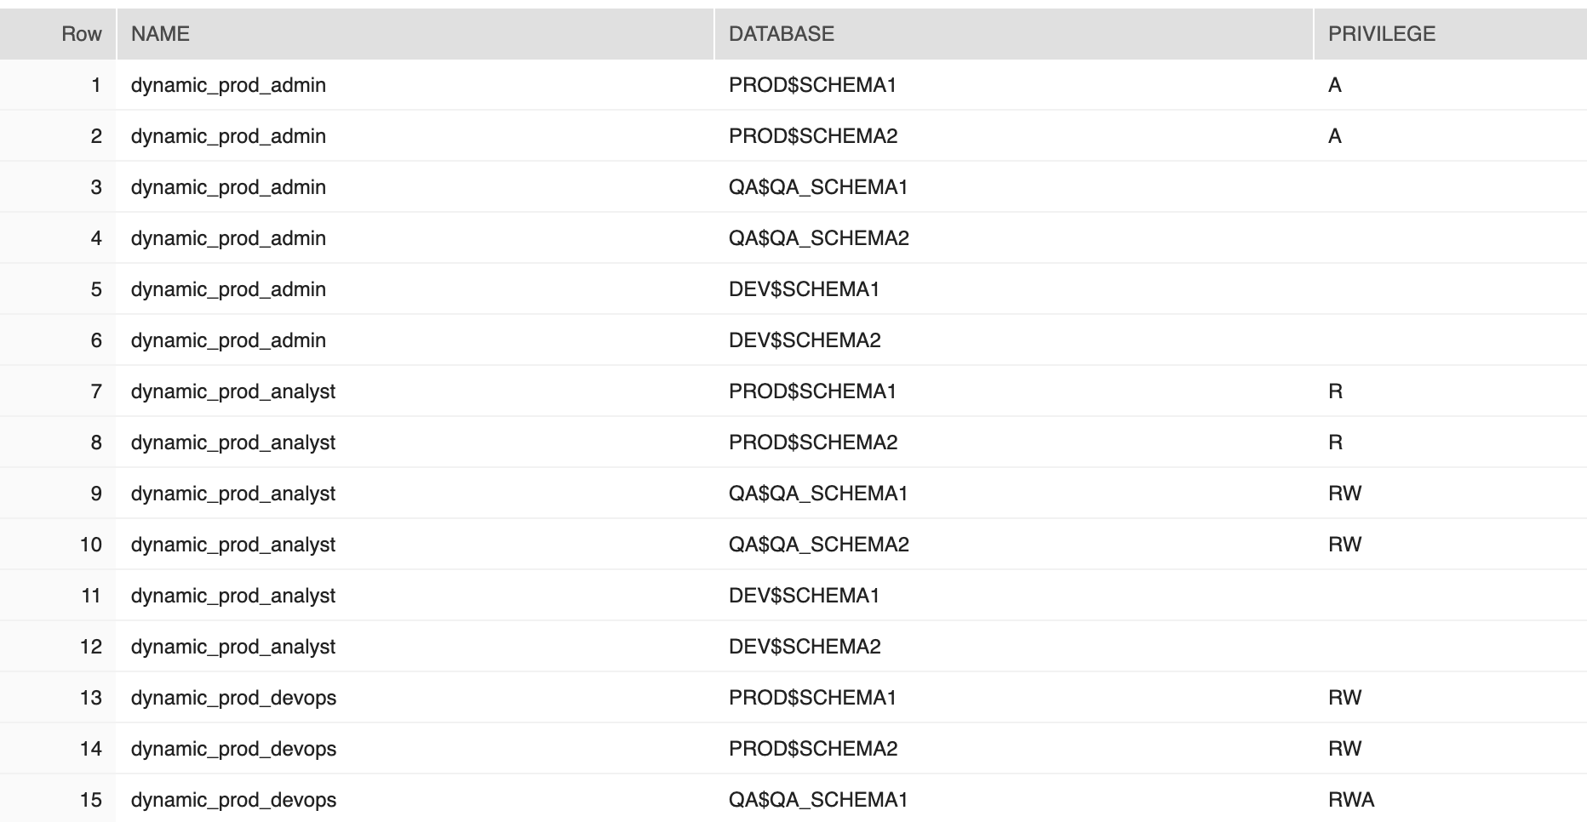
RBAC_DB_ACCESS_MNGD from ‘table-2.csv’
Notes:
Un-Pivoting result for processing with Role level

Slide 17
CODE PREVIEW
Notes:
Do the recap at the start of the next day versus the end of the current day.

Slide 18
Application Details
HTML Pages with JExcel
Python application to move data to Snowflake tables
Stored Procedures
Notes:
JExcel - free tool
Python - just read and copy data
SP - main logic

Slide 19
RUNNING APPLICATION

Slide 20
FUTURE IMPROVEMENTS

Slide 21
Organization and Accounts
Add a new functionality to work with Organization level
Notes:
Can be preset with Roles and Schemas, can be stored as JSON or Image

Slide 22
Link Data From Providers
Connect to MS ADFS, Customer Database, Provided Roles grouped by Line of Business, pass them to a Graph Builder
Get list of access role from Snowflake related to provided functional roles, pass access roles to a Graph Builder
Add the Access Roles and Database objects to the Graph Builder and link Functional, Access Roles and Database objects
Notes:
Can be preset with Roles and Schemas, can be stored as JSON or Image

Slide 23
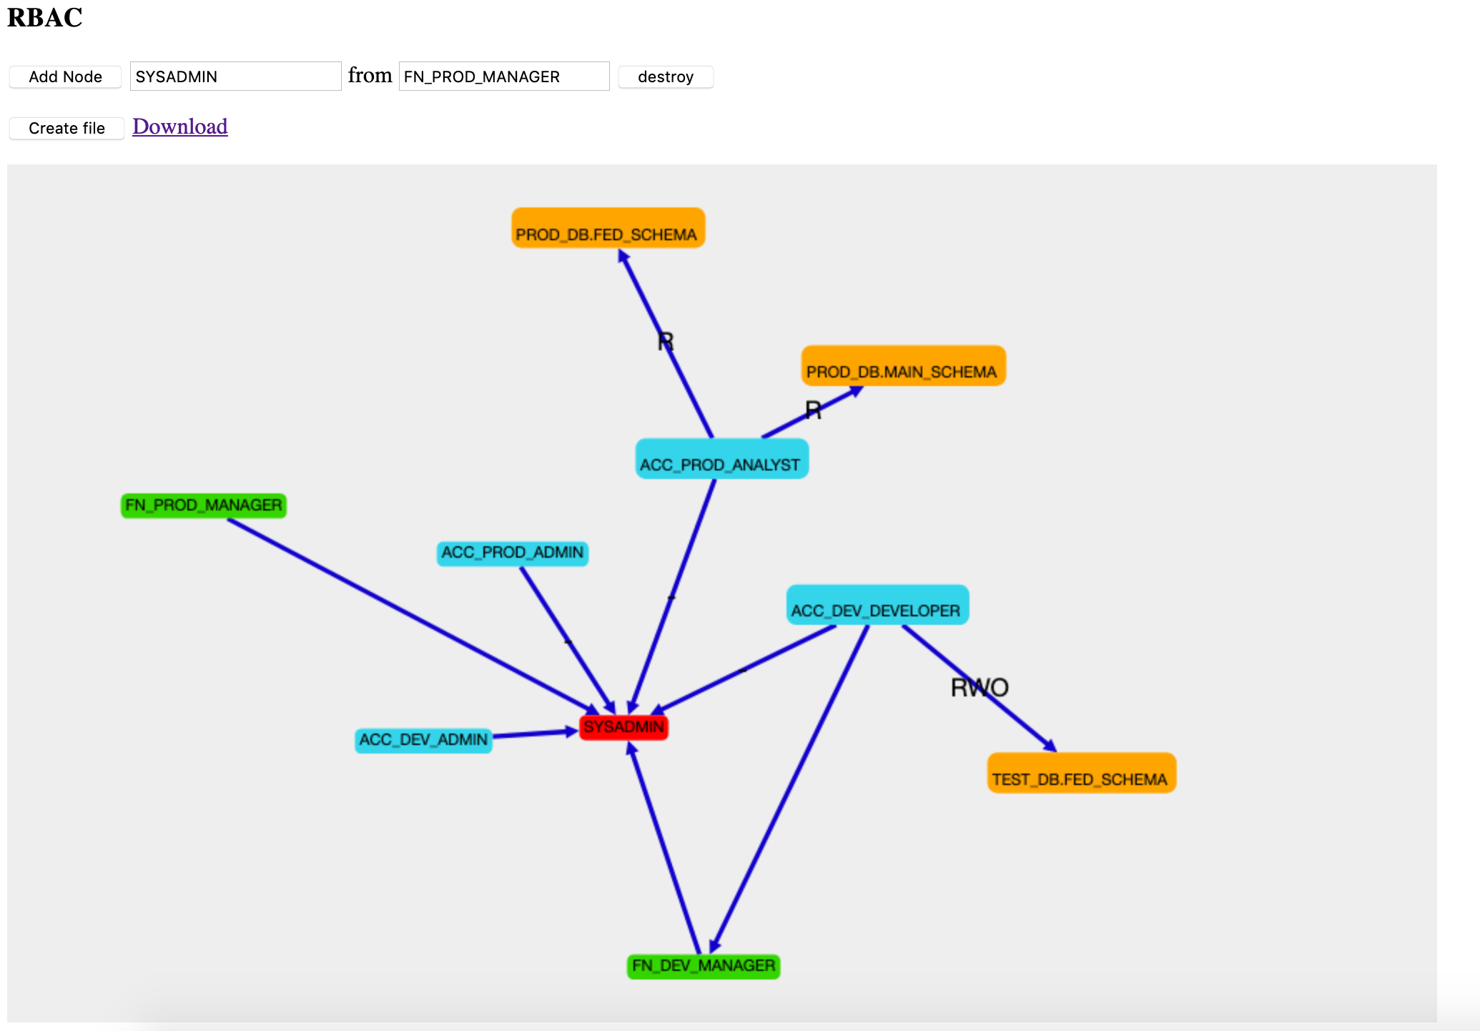
Create RAM from Graph
Create a graph for Roles and RBAC object relations
Notes:
RBAC – Access – Matrix
Can be preset with Roles and Schemas, can be stored as JSON or Image

Slide 24
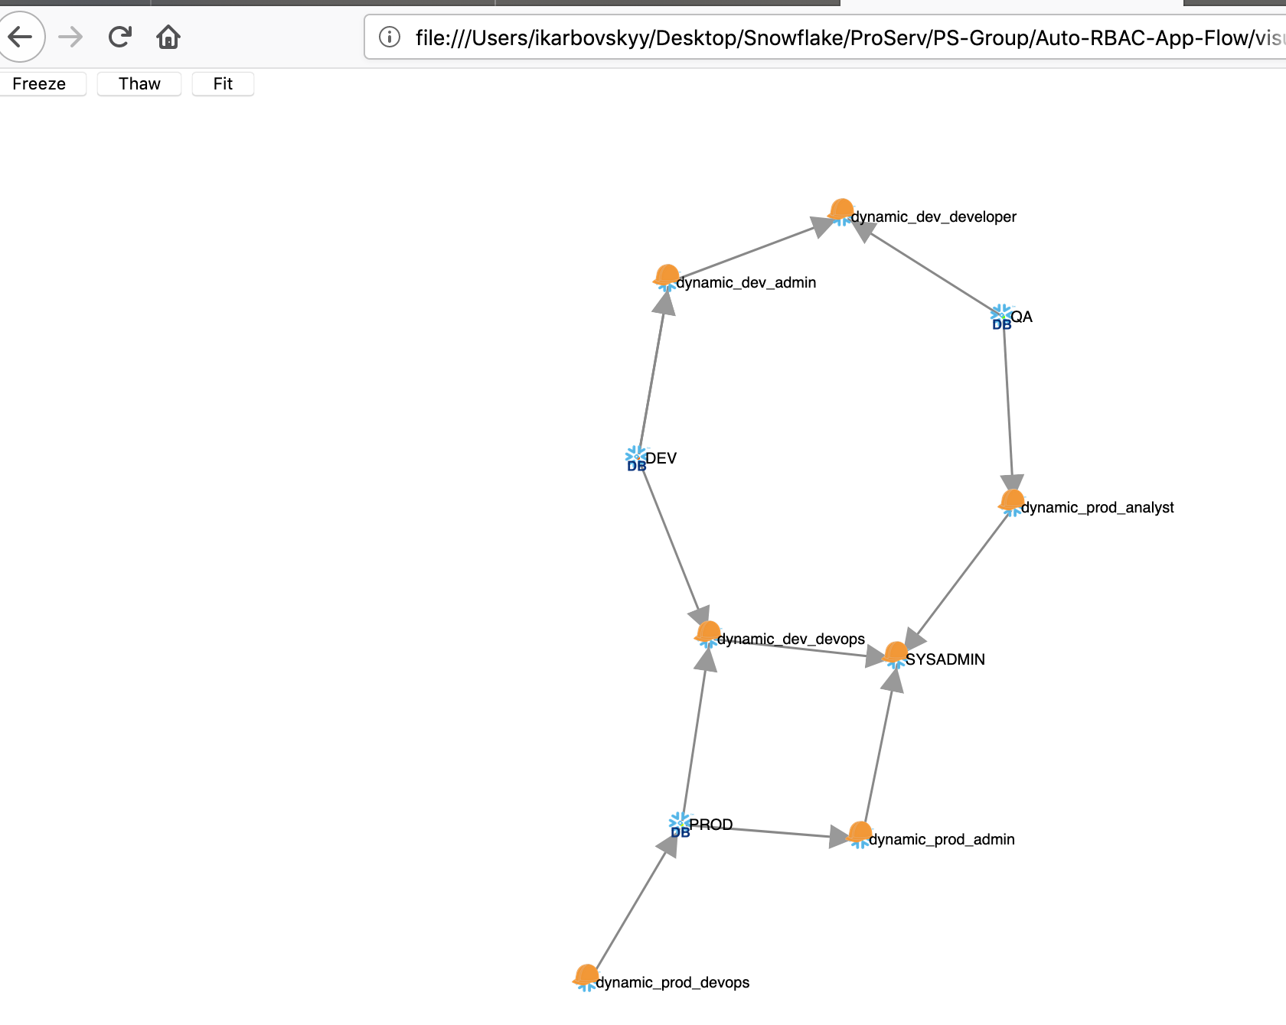
Show Roles to DB Object relations
Roles to DB Objects Visualization Graph
Notes:
Can be preset with Roles and Schemas, can be stored as JSON or Image

Slide 25
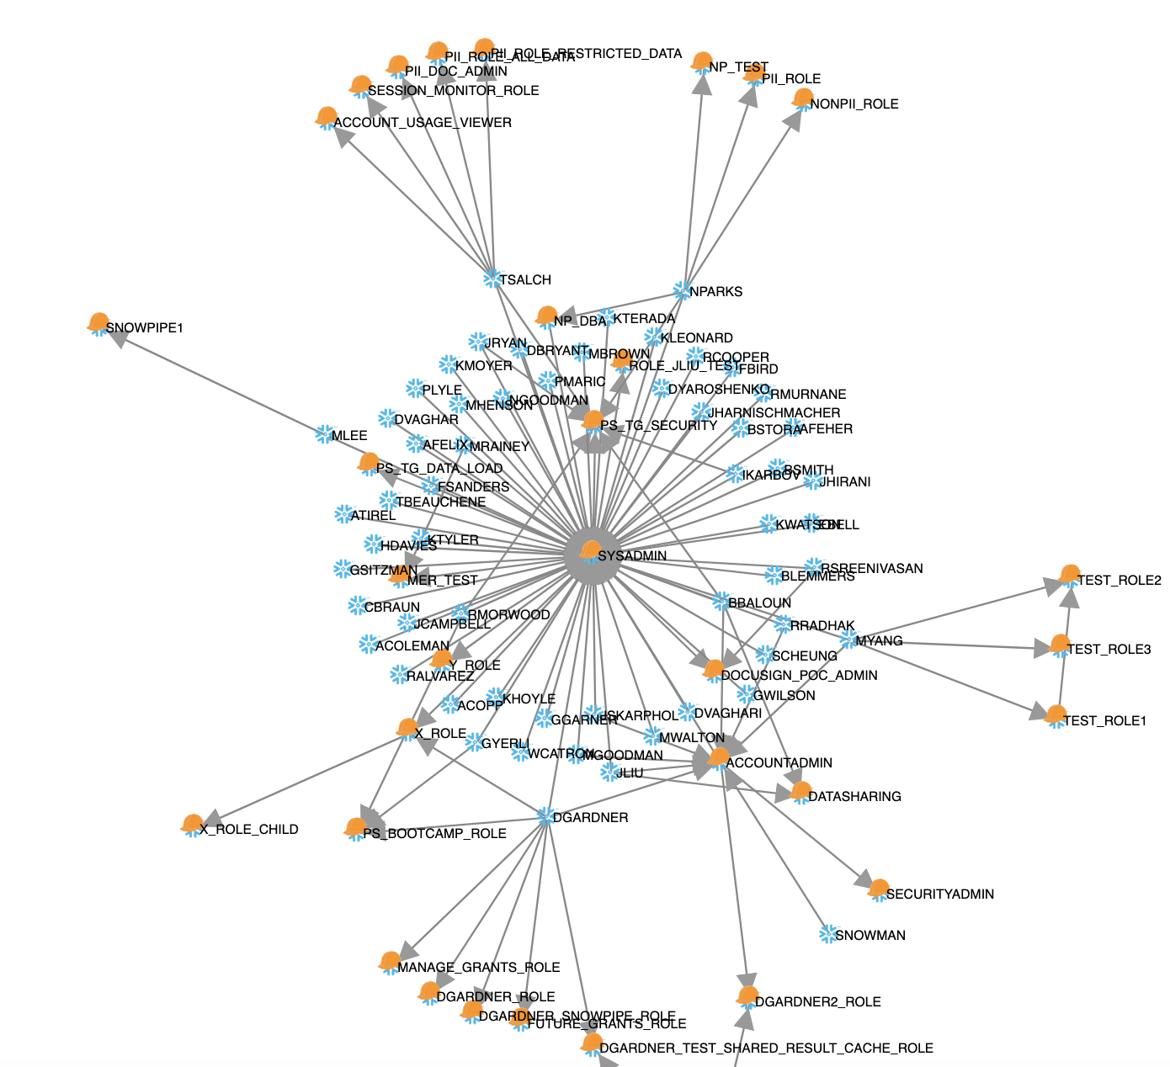
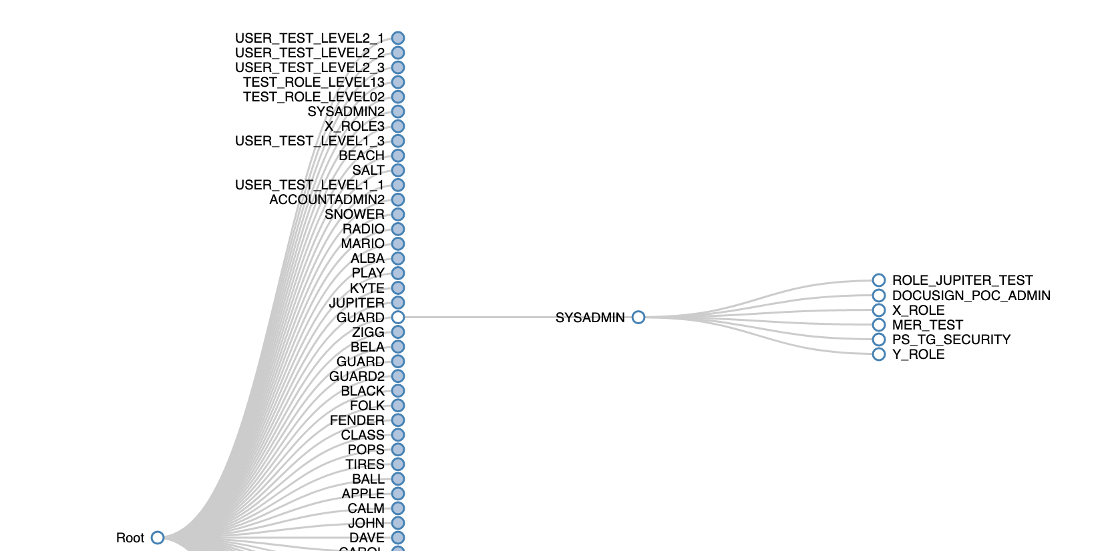
RBAC Visualization
Roles to Users Visualization Graph

Slide 26

ICONS
Snowflake DB
Data Warehouse
Data Lake
Datamart
BI Analytics
Server
Enterprise
Optimized Structured Data
Structured Data
S3 Data Protection
Alert
Process
User / Customer
Web App
Tools
Third Party
World / Global
Azure Blob
Check
GCS
Desktop
Mobile
Application
Document
IoT
Data Science
Cloud
Optimization
Metadata
Transactions
Refresh
Services
Metadata / Tag
Security
Results
Third Party Apps
Access Control
Easy Management
Dev
Communicate
Results
No
Edit
Optimize

